Slide 1
Zone Creation
Collin Baumgart Next Level Ag Agronomist

Slide 2
Bareground Maps
SOIL:
Soil Color, Organic Matter, Texture
WATER:
Nutrient Movement, Salinity, Organic Matter, Erosion
TOPOGRAPHY:
Elevation, Water Movement, Hills/Slopes, Depressions

Slide 3
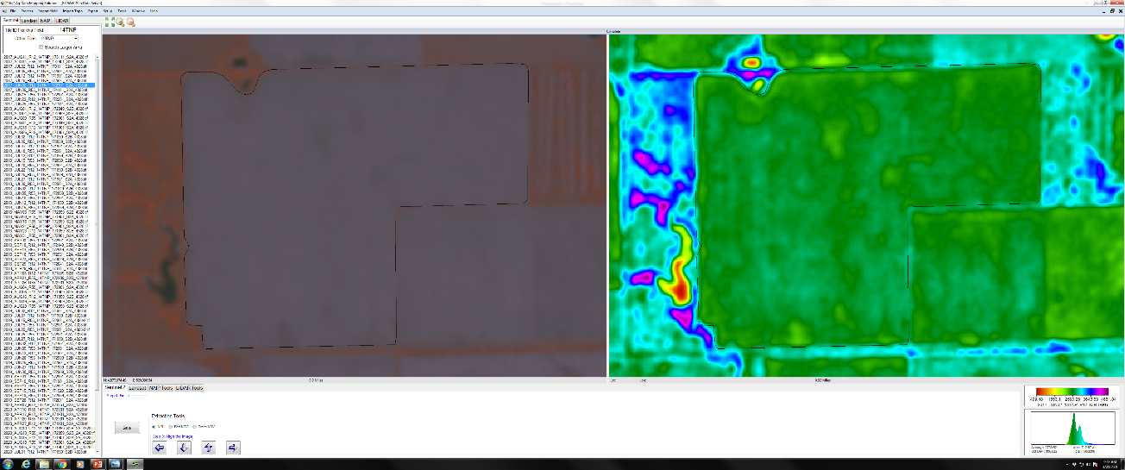
Soil: NIR Images Bare Soil Images
Satellite imagery is pulled from multiple years and months of bare soil data.
Images are run through a correlation matrix. The best images are selected.
The final product shows the difference in soil throughout the field.

Slide 4
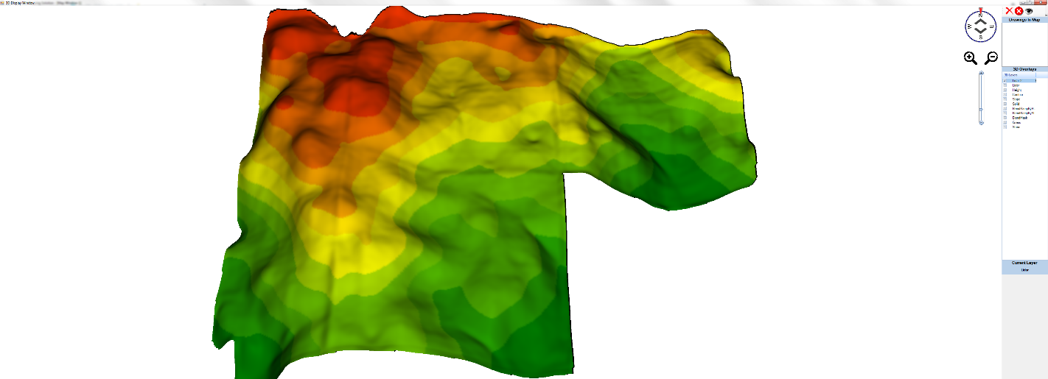
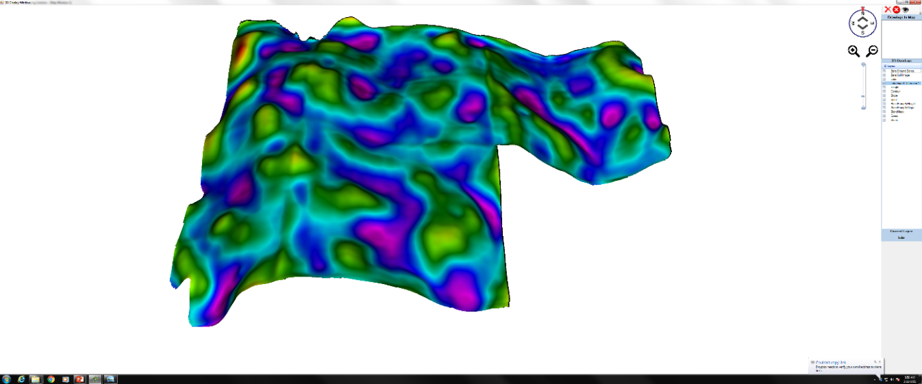
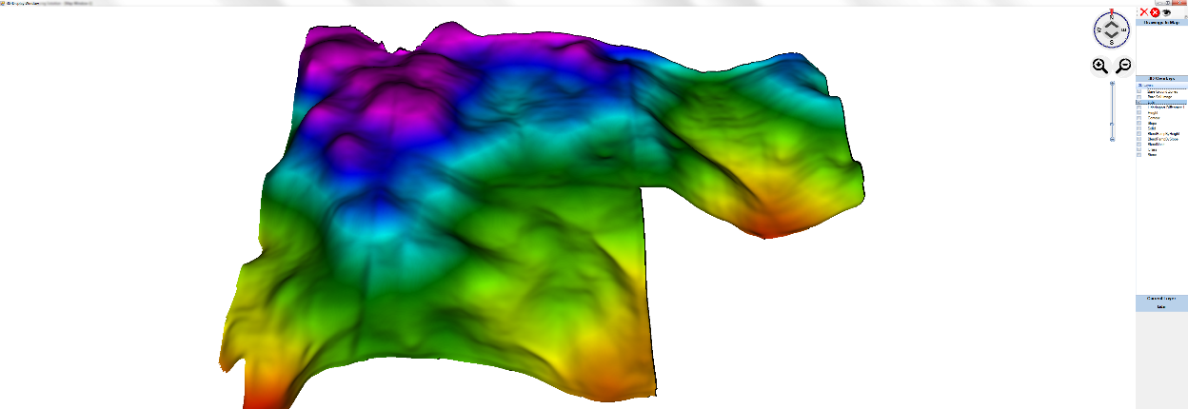
Topography: 3D Lidar
Lidar data is used for elevation and creating a topography layer
This layer will show how water will potentially move throughout the field
This layer helps determine which areas of the field will dry out first as well as which areas will hold moisture

Slide 5
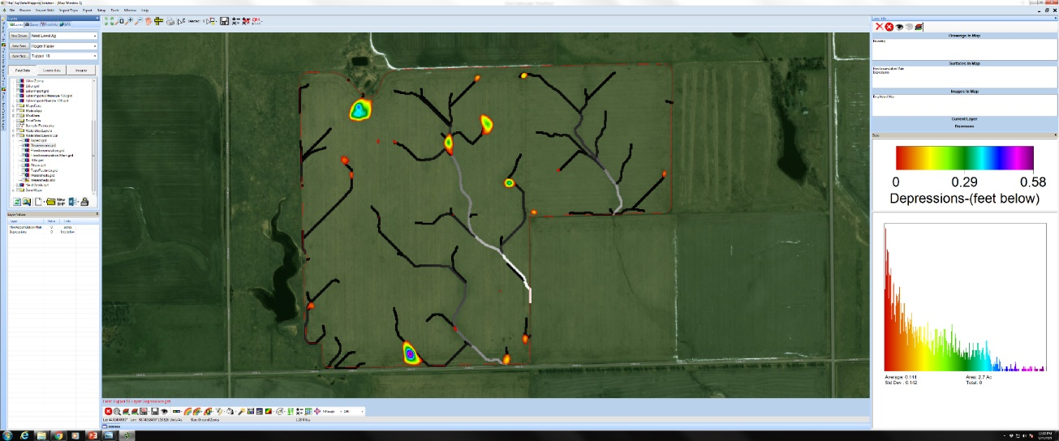
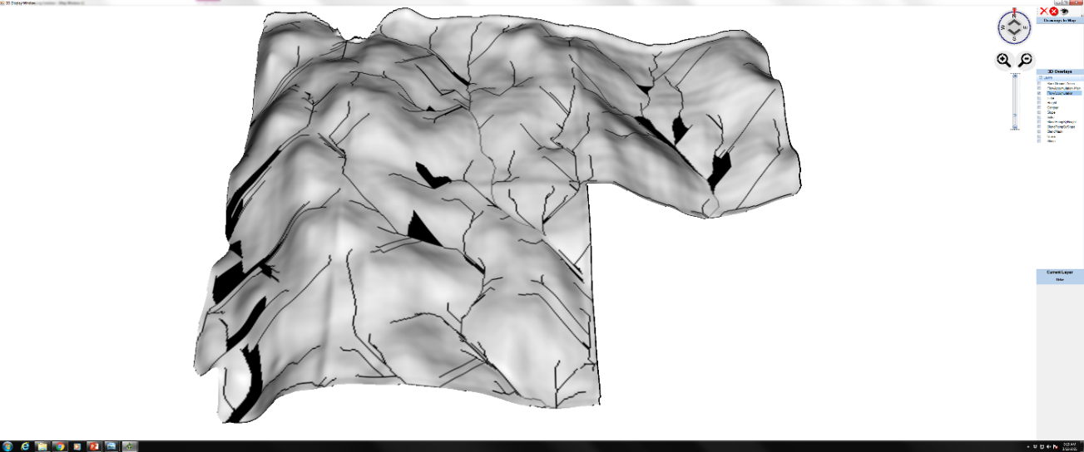
Water Layer
Shows water collecting depressions along with water movement

Slide 6
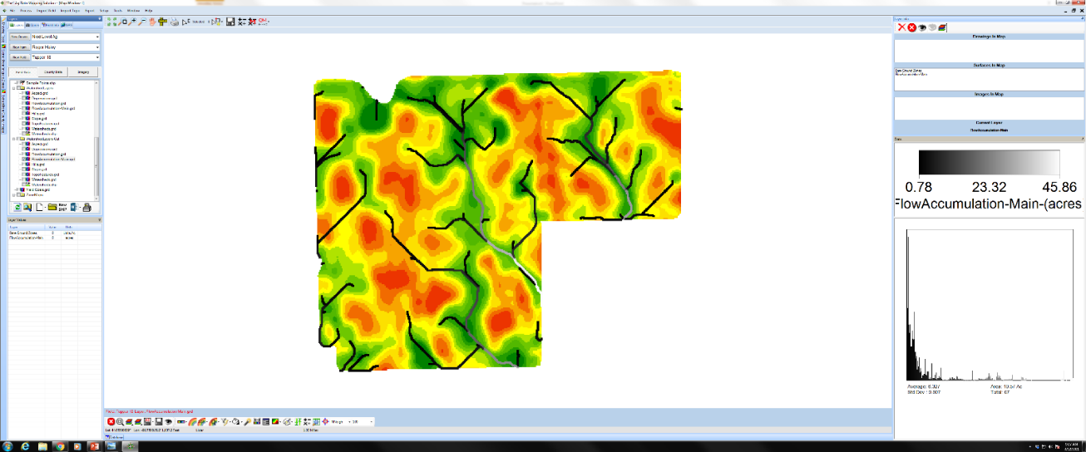
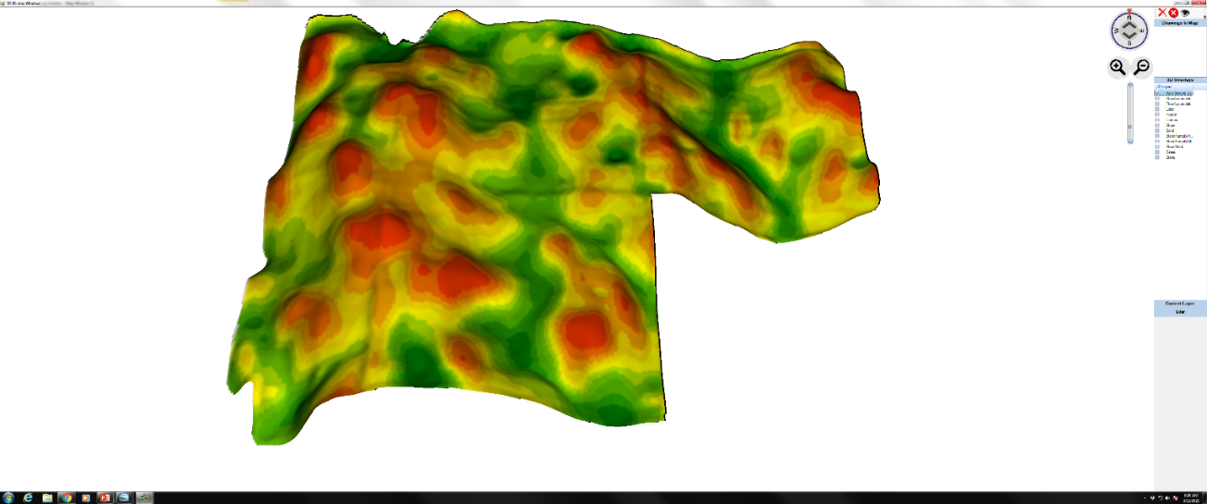
Putting it All Together
All layers are combined to make the final zone map
Different weights can be given to each layer to better fit each field

Slide 7
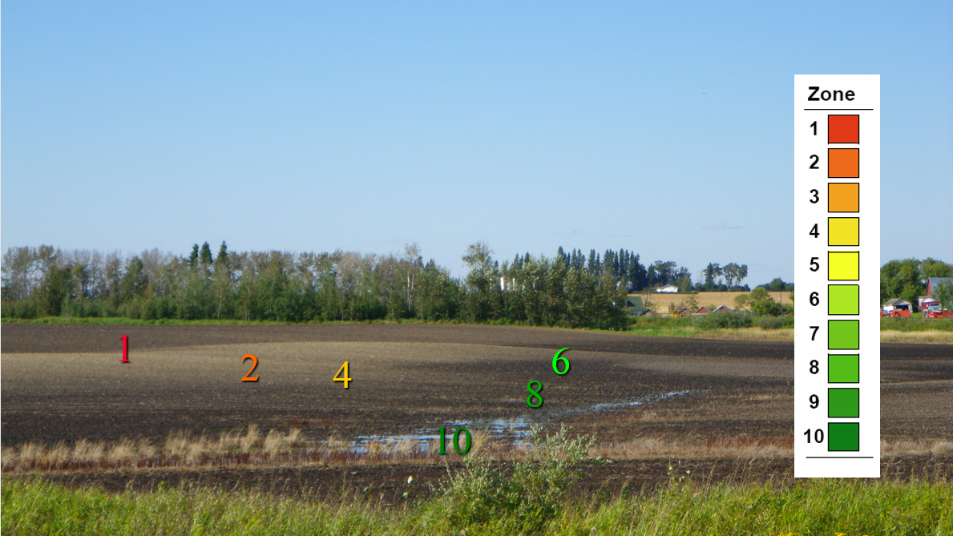
Zone #’s

Slide 8
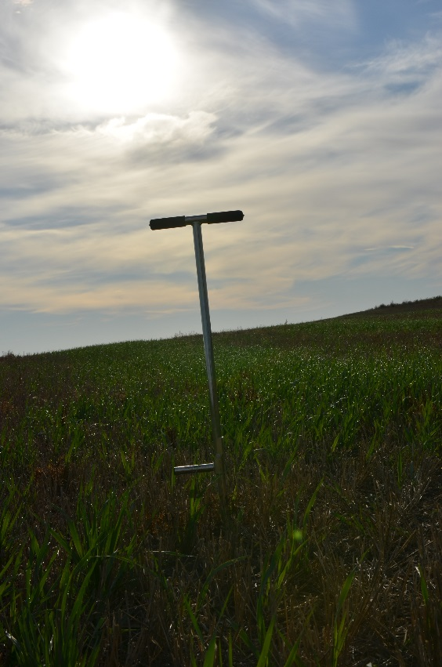
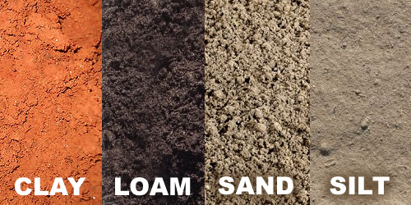
Sampling Zones
0-50ac.=5 zones
50-75=7 zones
Above 75 acres=10 Zones
Sample from half zone (1,3,5,7,10)
0-6” typical sampling depth, 6-24” subsample
5-15 sample cores from each zone - dependant on zone size
Indicator Complete Soil test from Next Level Ag Labs

Slide 9
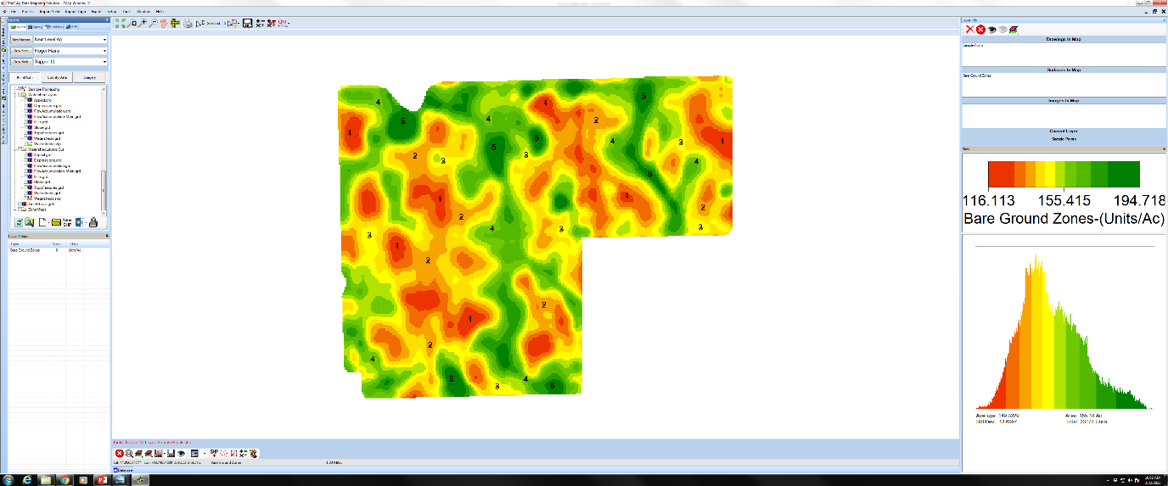
Sample Points

Slide 10
Questions/More Info
Call (605)-461-3936
Email: collinb@nextlevelag.com

